Slide 1
CSC207 Phase 0 Report
Tian Shu, Canyang, Shihan, Yuelin, Yiteng, Mihir

Slide 2
Specification:
HR System
User → Employer or Employee
a username, a password, salary, attendance, id
Employee: access information
Employer: access information of all users, has editing capability
UI Commands
create the personal profile for new employees
allow the employer to change information of employees
allow employees to check their information. e.g. salary and id
exit the system

Slide 3
CRC Model

Slide 4
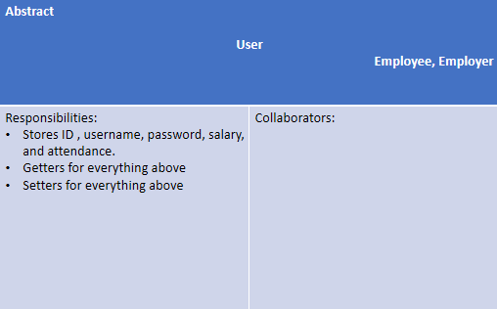
CRC Model

Slide 5
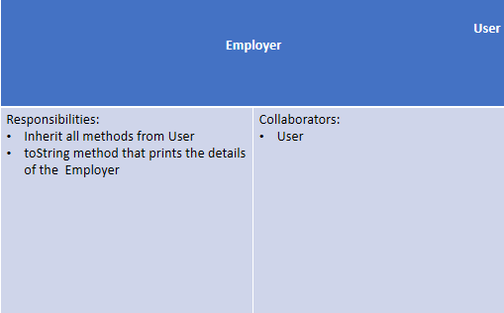
CRC Model

Slide 6
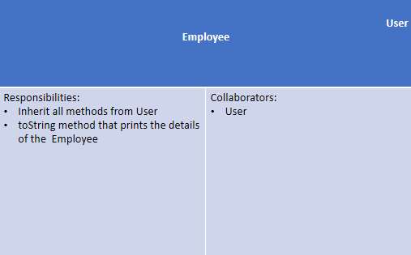
CRC Model

Slide 7
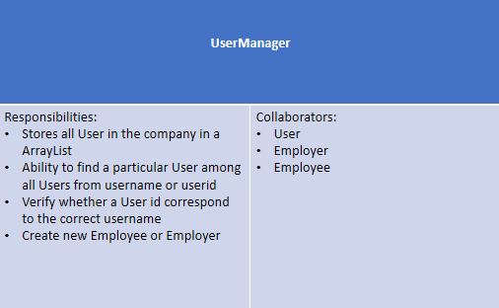
CRC Model

Slide 8
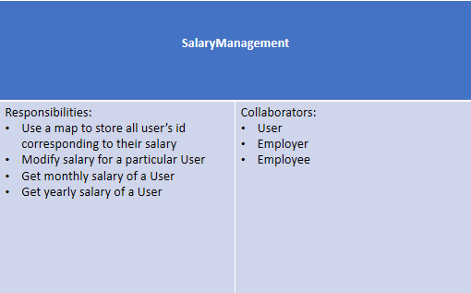
CRC Model

Slide 9
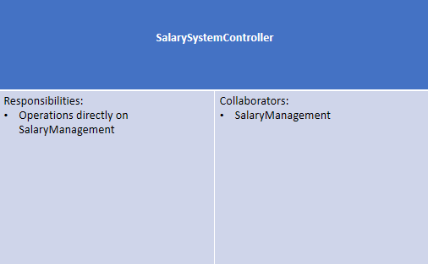
CRC Model

Slide 10
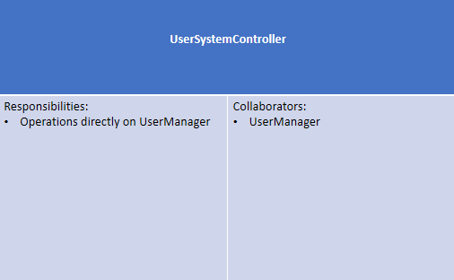
CRC Model

Slide 11
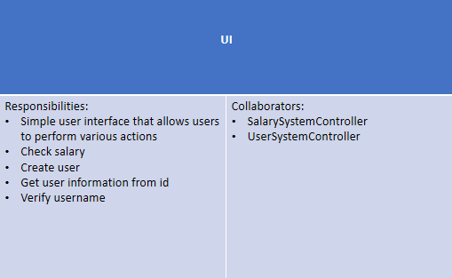
CRC Model

Slide 12
Scenario Walk Through
Employer Scenario:
Firstly, employer uses this HR system and the system shows him the log-in page using the UserSystemController.
Register himself through the registration button UserManager use case, we will need to enter his ID, username, password, salary, and attendance.
After he successfully registered himself, the system will send him back to the login page.
The employer logins in, then we can see a list of all the employees with their detailed information.
The employer has access to all the files and can edit if the employer wants to raise or lower an employee’s salary using the SalaryManagement use case of the SalarySystemController.
Noticed that only the employer has the authorization to create an employee account. (So far, everyone can create a User since our code did not add the restriction on different users’ rights.)
Employee Scenario:
An employee who is recruited by an employer should get his username and temporary password from the employer. The system will show the employee the log-in page, he will use his username and password to login in.
We believe the first time the employee logs in, the system will ask him to reset the password (since normally it is a temporary password).
The employee logs in to the system and he can see his profile page, he now can see all his personal information including the attendance and the detailed components of his salary.

Slide 13
Skeleton Program
Designing a program that keeps track of three different types of users in the HR system: the employer, the employee.
Each user is given an ID, username, password, salary and attendance value that is associated with them.
The employer should be able to add new users or update user information in the system.
The SalaryManagement case class : Track the monthly and yearly salaries of every user in the system using their IDs.
The UserManager case class: Access all the users in the system using their usernames and IDs.
The SalarySystemController uses the SalaryManagement case class
The UserSystemController uses the UserManager case class.

Slide 14
Teammate Contribution and Plan

Slide 15
Tian Shu
What I’ve done so far:
CRC model and some Unit Tests
Plan for Phase 1:
Expand CRC model
more necessary controllers and use cases (e.g. Fireable Interface, Intern class)
Write Unit Test before the implementation of new classes and interfaces
test-driven design

Slide 16
Canyang
What I’ve done so far:
I wrote some use cases, controllers and UI
Plan for Phase 1:
Expand use cases, controllers and UI(GUI)

Slide 17
Shihan
What I’ve done so far:
Comments
Unit tests
Plan for Phase 1:
Checking mistakes/Debug through writing comments and Unit tests.

Slide 18
Yuelin
What I’ve done so far:
Scenario Walk Through, Specification
some code, annotation
Plan for Phase 1:
Implement more controller class to enhance user experience.
Connect use case and controller better

Slide 19
Yiteng
What I’ve done so far:
I wrote some use cases, controllers and UI
Plan for Phase 1:
Expand use cases, controllers and UI(GUI)

Slide 20
Mihir
What I’ve done so far:
Progress Report
Plan for Phase 1:
Expand Use classes and interfaces - leave days for attendance for users

Slide 21
What Worked Well
multiple entities with inheritance (User, Employee and Employer).
Use cases that interact with the entities
Methods in two controllers to interact with use cases.
implemented a user-friendly interface in our UI part
registration
login
salary check
Thought through new classes: Schedule Classand fireable Interface.
possible GUI system
unittests for methods in Entity, Use Case, and Controller

Slide 22
Open Questions
If UI system require user input to be type String, but an integer is entered, the program will not proceed. Then, the user need to restart the program. We need ways to make the UI more user friendly.
Now, every User data we entered is temporary, so we want to find a way to store the data permanently, for instance in a database. This means if we re-run the program, we can access and edit the stored old User data.

Slide 23



Can we get Full Mark?

Slide 24


Thank You

